Slide 1


Smart Home
AVR Embedded System Project
(ATMEGA32)

Slide 2

Team Members
1.Ahmed Nashaat
2.Ahmed Emad
3.Taha Gamal
4.Amr Bahgat
5.Beshoy Nagy

Slide 3
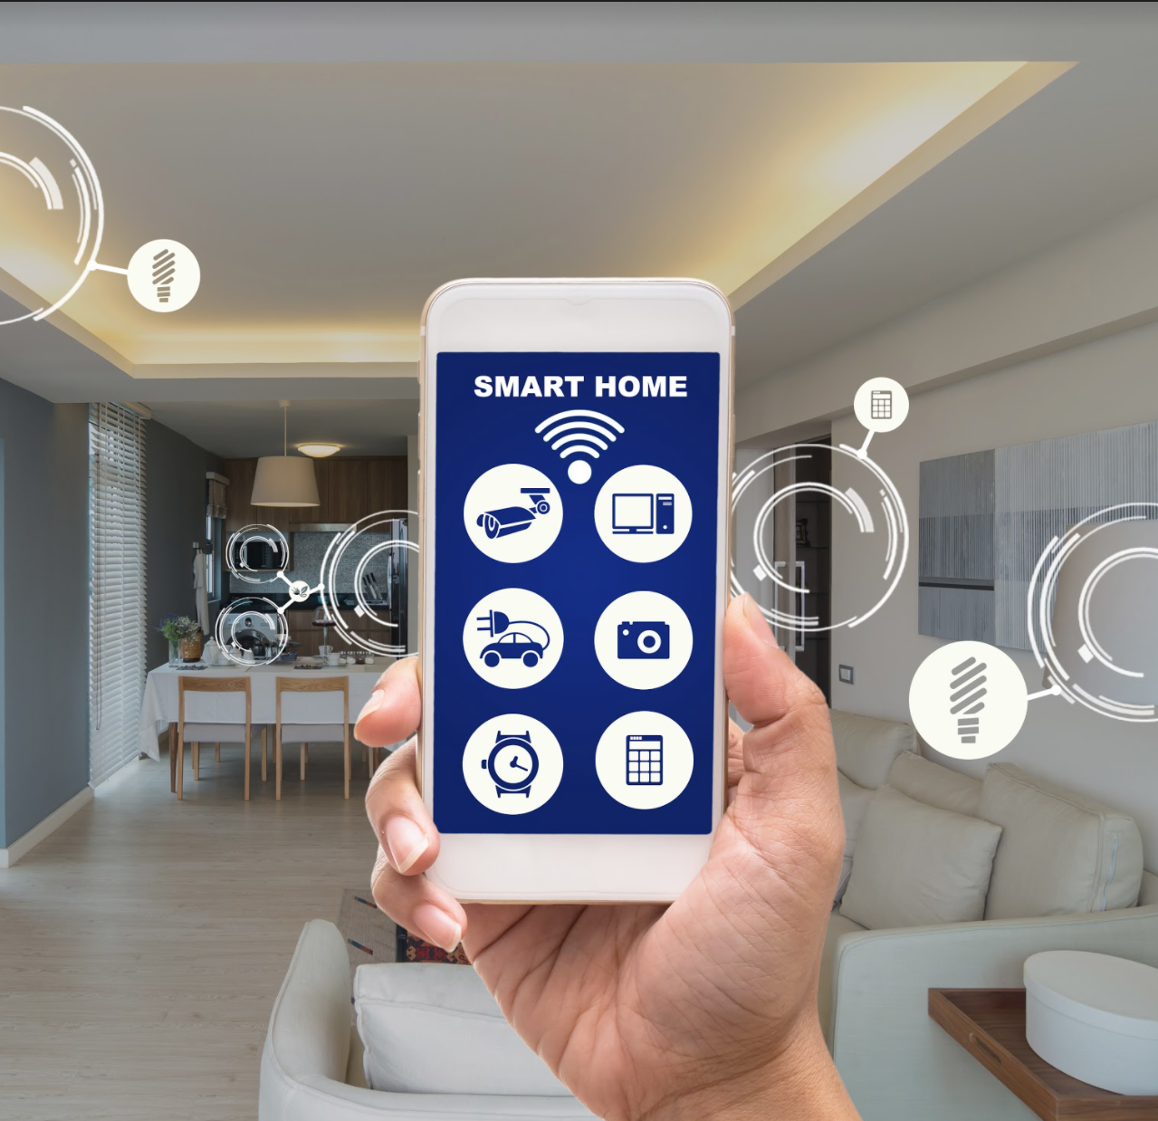
Introduction
smart home refers to a convenient home setup where devices can be automatically controlled remotely from anywhere with a Wireless communication protocol such as Bluetooth using a mobile or laptop. Devices in a smart home are interconnected through the Bluetooth, allowing the user to control functions such as security access to the home, Air Condition, lighting, and Door Opening remotely.

Slide 4
Tools used in the implementation of the project
Microchip Studio
Proteus 8

Slide 5
System Capabilities
Control The Door opening , Room Lighting and Air condition
Air condition automatically turned on turned off According to the Temperature of the Room
Secure system, If admin or any user or passwords are entered wrong more than 3 trial, the system break down and fire alarm until reset.
Remoted controlled by mobile or lab top
Contains two Modes (User Mode & Admin Mode)
Admin Mode can add users and control all devices at the system
User mode can log in Remotely or by Keypad and LCD

Slide 6
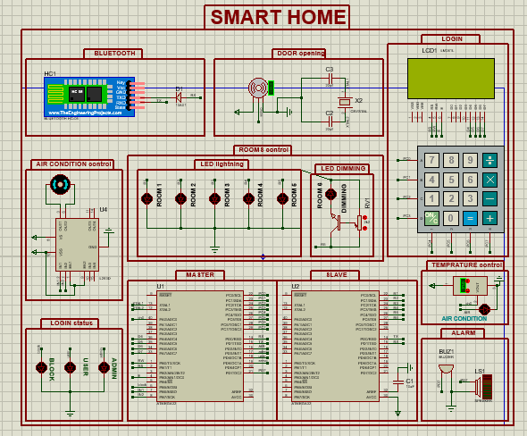
Proteus Design

Slide 7
System Actuators
Admin
User

Slide 8
System Modes
Admin Mode
Admin mode can access all devices
Admin who only can add users to control the system
Admin can log in with Bluetooth only
User Mode
User mode can access all devices expect the door
User mode can log in with keypad or Bluetooth

Slide 9
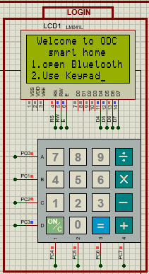
Start to control system At first the user must select the manner to control the system
If the user choice is keypad the control transfer into Keypad and LCD.
If the user choice is Bluetooth the control transfer into the Bluetooth control, and the system will respond to the commands that sent to it from Bluetooth module.

Slide 10
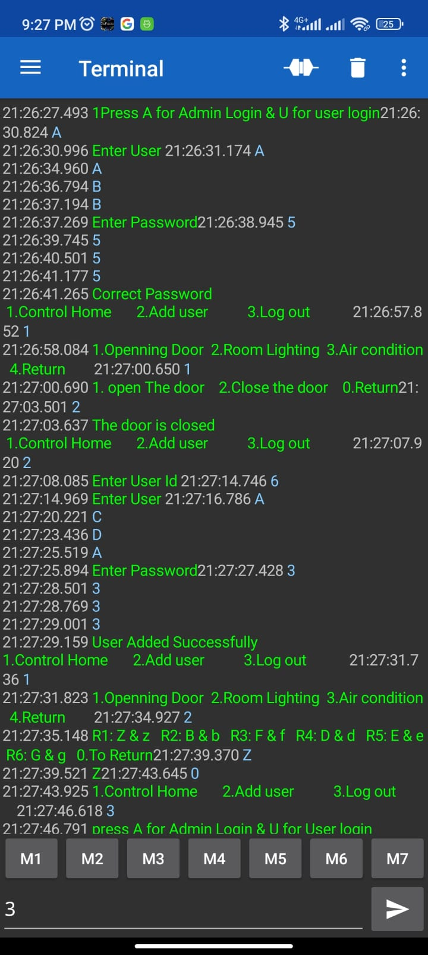
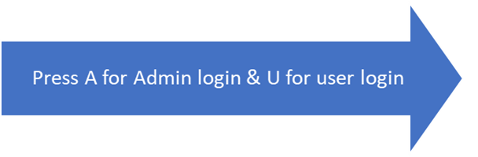
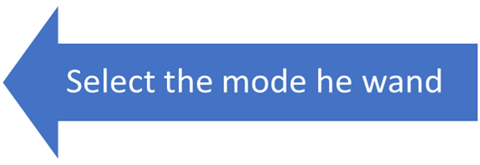
Bluetooth control Automatically the system connected to Bluetooth to control the system, the user must connect his mobile or laptop to Bluetooth and begin to receive and transmit commands
Send username and Password
Enter Username and password

Slide 11
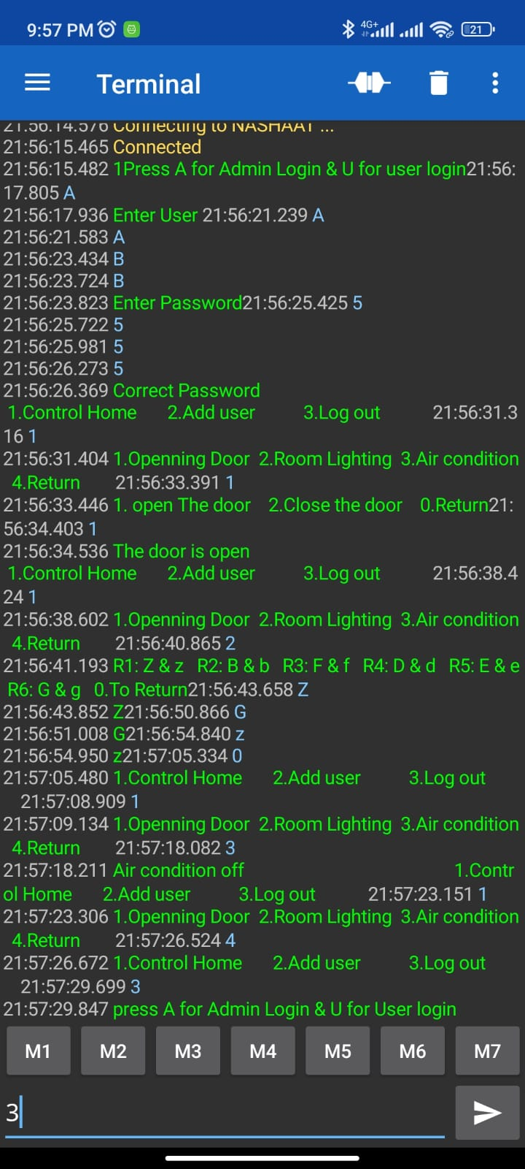
Bluetooth control
In Bluetooth control, Admin and user can control the home remoted, they can control the Room LEDS, Air condition and door opening.
In controlling the Rooms sending the Capital letter is turn on the LED and Sending it small will turn of the LED and the actuator can turn of and turn on them until he send command to return the main menu.
Also , actuator can see the current status of air condition which turned on and turned off according to room temperature.

Slide 12
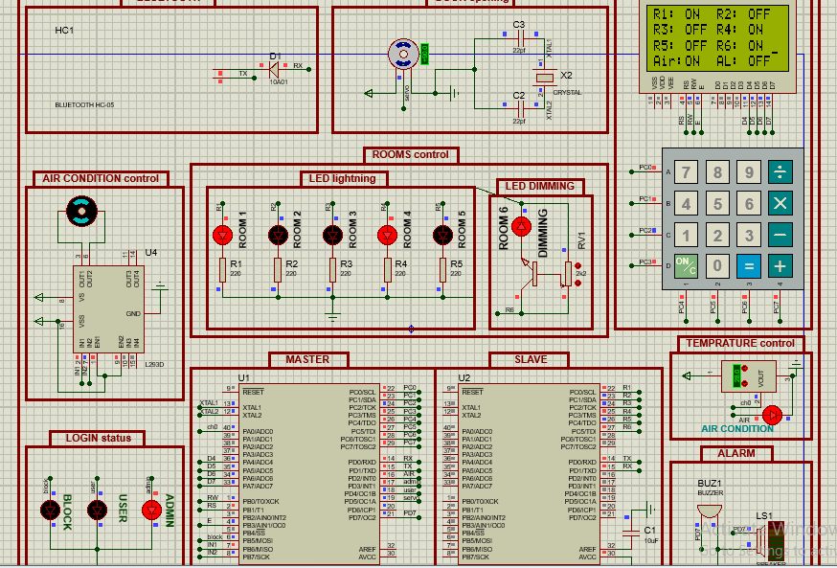
Bluetooth control
At Bluetooth control way LCD used for display the status of all devices in the system.

Slide 13
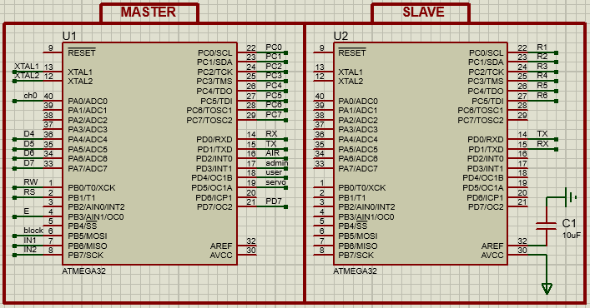
Microcontrollers of the design
We use two microcontrollers (ATMEGA32), Master and Slave. Master control the whole system, slave used to connect other devices in it. slave receive the orders from the master by UART communication protocol and implement it

Slide 14
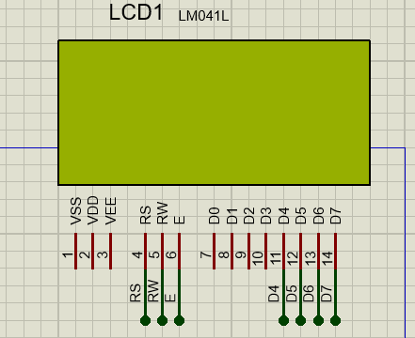
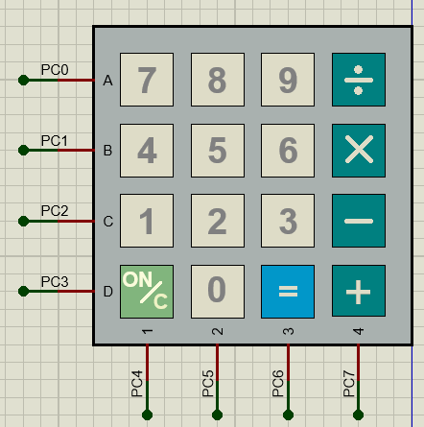
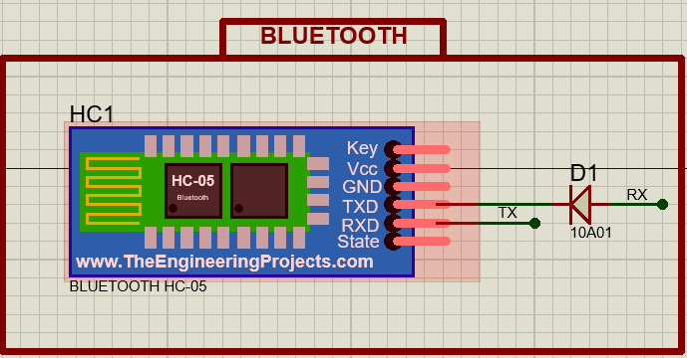
Communication Components in the proteus design
LCD (LM041L)
For displaying messages
Keypad
Take inputs from user and login through it
Bluetooth Module(HC-05)
To receive and transmit commands

Slide 15
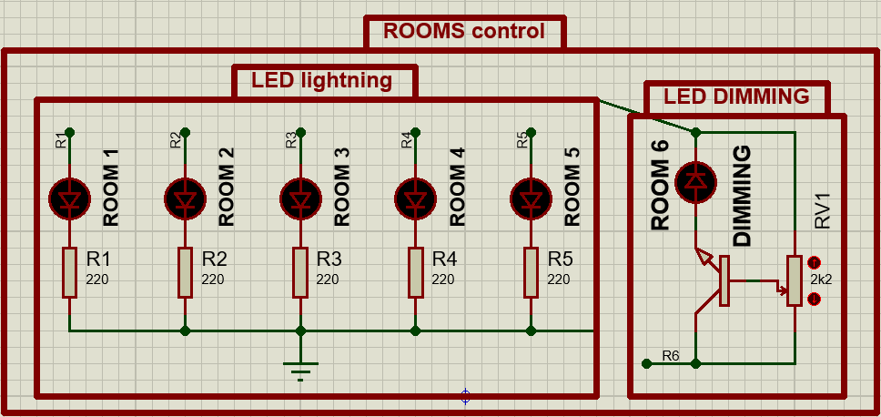
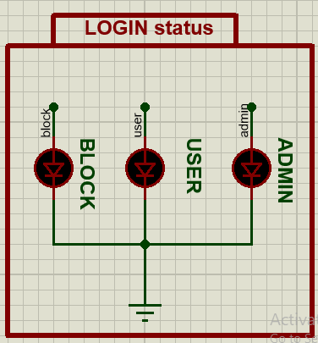
Controlled components in proteus design (LEDS)
LEDS that represent the Room Lighting
LEDS that represent the Login status

Slide 16
Bluetooth
Master
UART
Control Rooms
Slave

Slide 17
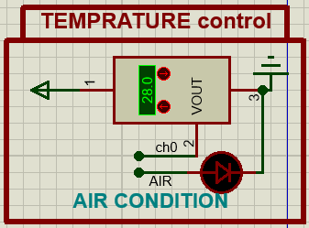
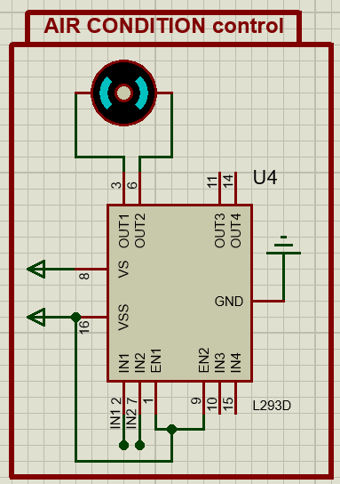
Controlled components in proteus design (Air condition)
We represent the Air condition with DC Motor using L294D driver to interface it with the microcontroller.
Temperature sensor (LM35).

Slide 18
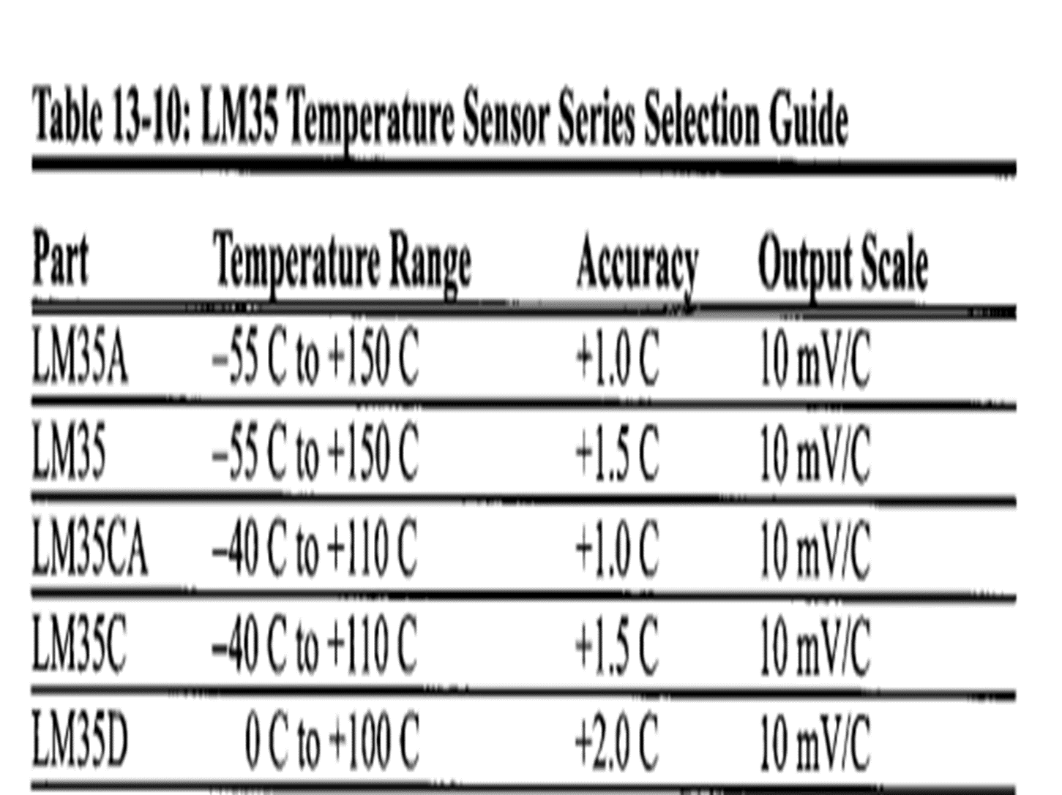
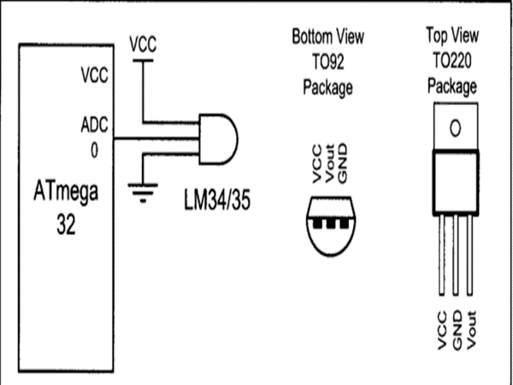
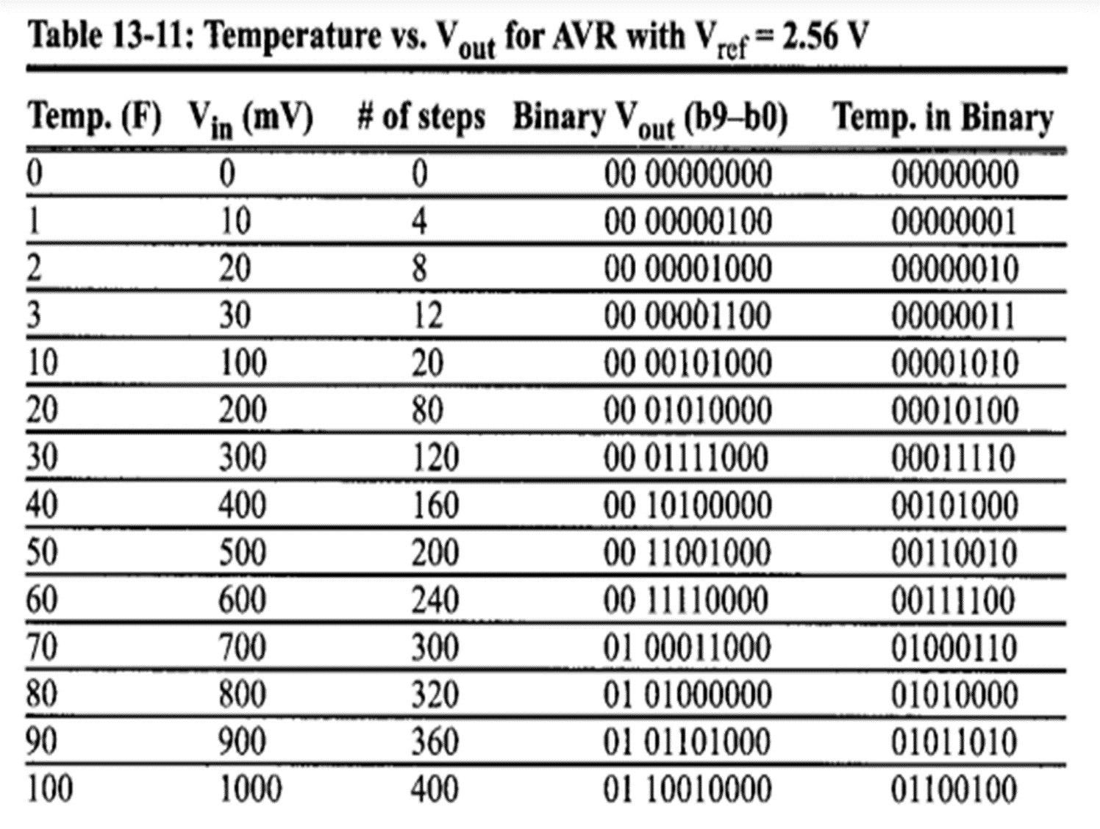
LM35 temperature sensor

Slide 19
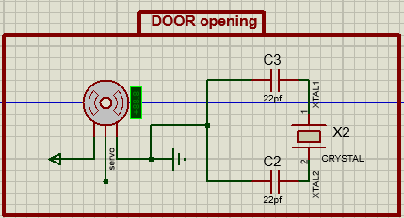
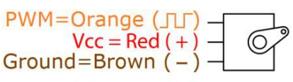
Servo Motor
We represent the door by servo motor
It’s DC motor have Position Control by small encoder
Pins
Have 3 pin ( PWM , Vcc , GND )

Slide 20
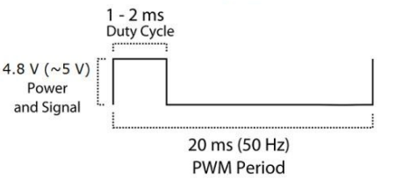
Servo Motor
Motor moving from 0 degree to 180 degree
Position "0 degree“ Duty cycle 1.5ms pulse is middle
Position “90 degree“ Duty cycle ~2ms pulse to the right
Position “-90 degree“ Duty cycle ~1ms pulse to the left

Slide 21
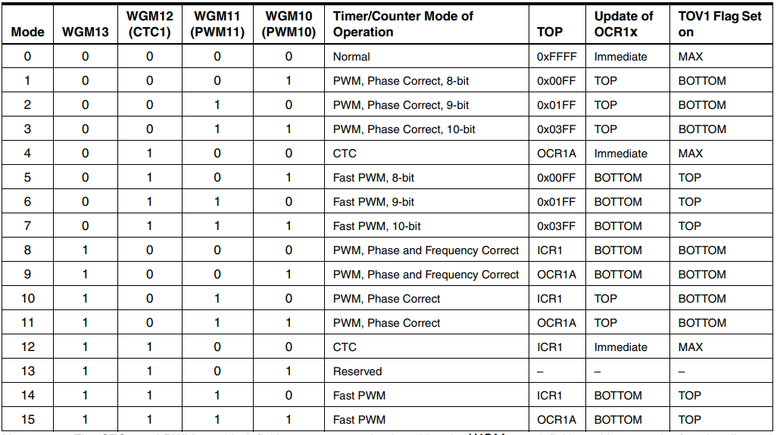
Servo Motor
We using Timer/Counter1 code
We can’t mode (4&5&6)
We will using mode 14
ICR1 = 2499

Slide 22
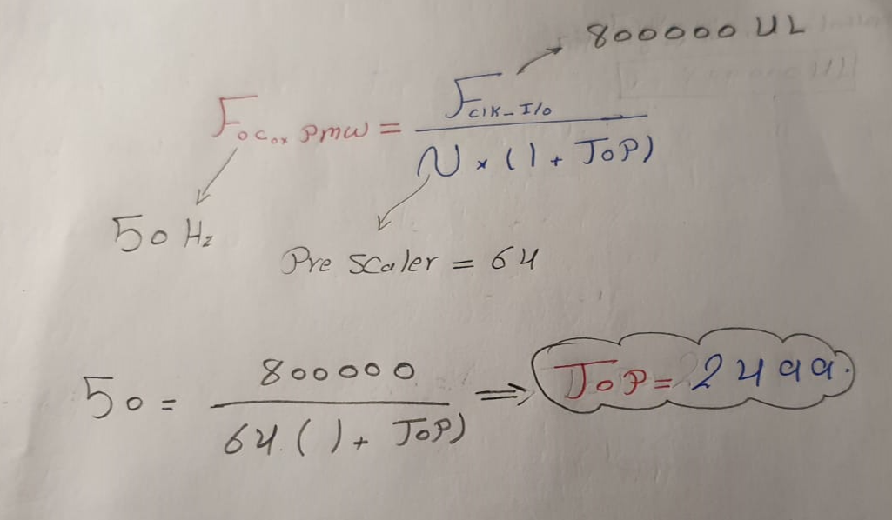
Servo Motor

Slide 23

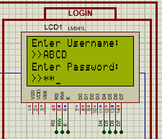
Keypad control
At emergency or user mode only the control of the system is transferred to Keypad and LCD, LCD will display the messages to ask user to log in with username and password, if username and password are correct the LCD will display the main menu to start control

Slide 24
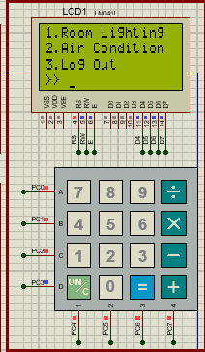
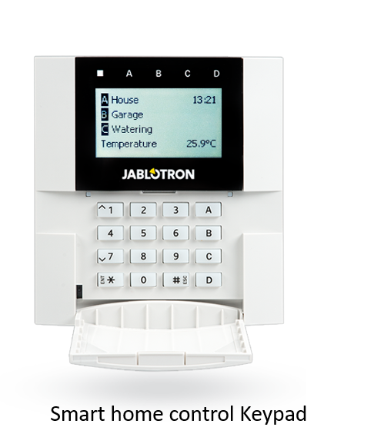
Keypad control (Main menu)
When the user log in successfully to the system, he can select the thing that he want to control from the menu

Slide 25
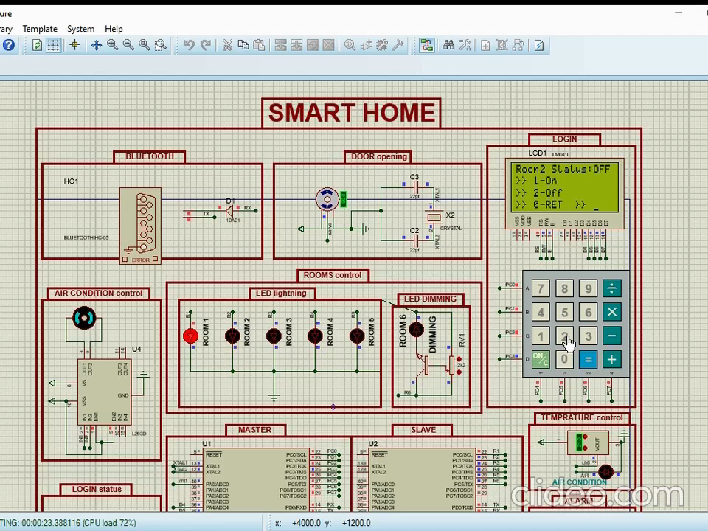
Room lighting control

Slide 26
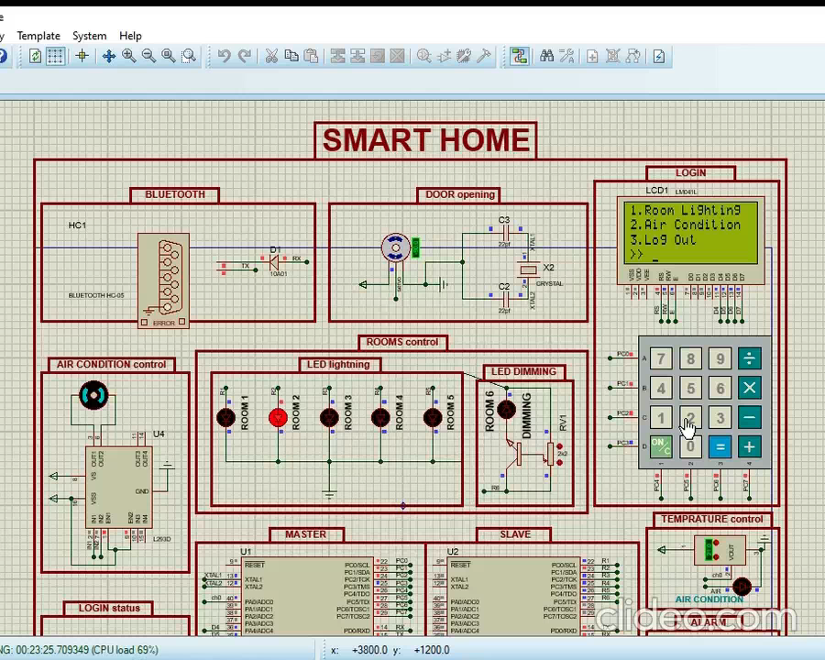
Air condition control

Slide 27

Thanks!

